Slide 1
Image Formation
Dr. Chang Shu
COMP 4900C
Winter 2008

Slide 2
Image Formation
The physics of image formation.
Geometric models of cameras.

Slide 3
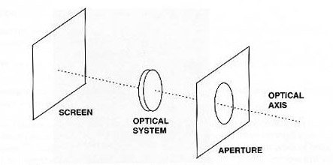
Elements of an imaging device
Light rays coming from outside world and falling on the
photoreceptors in the retina.

Slide 4
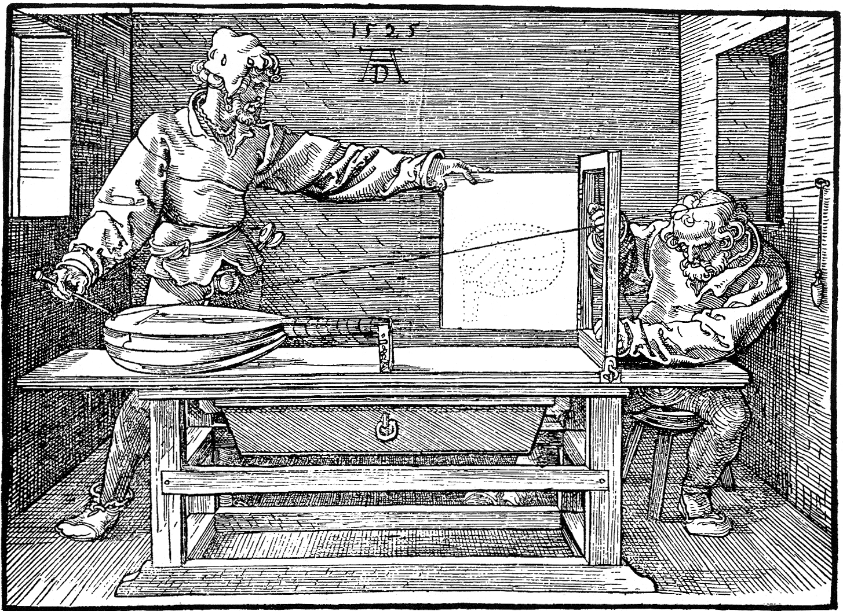
Perspective Projection
Draughtsman Drawing a Lute, Albrecht Dürer, 1525

Slide 5
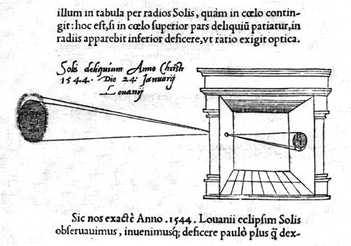
Camera Obscura
Camera Obscura, Reinerus Gemma Frisius, 1544
Camera Obscura: Latin ‘dark chamber’

Slide 6
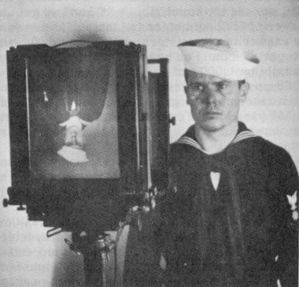
Photographic Camera
Photographic camera: Joseph Nicéphore Niepce, 1816

Slide 7
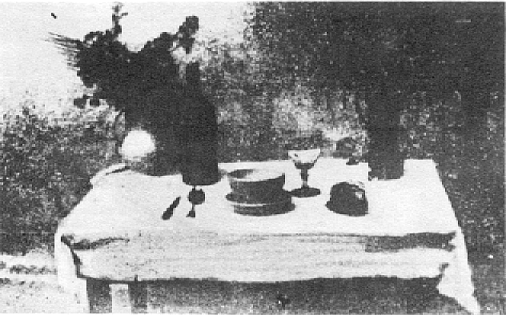
First Photograph
First photograph on record, la table servie,
obtained by Niepce in 1822.

Slide 8
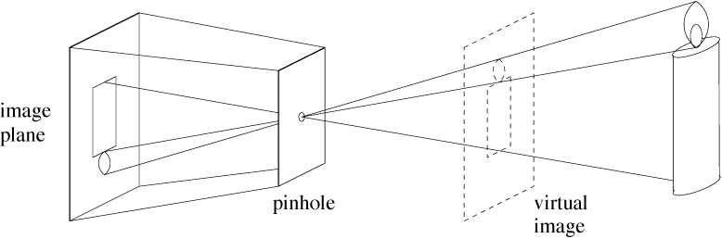
Pinhole Camera

Slide 9
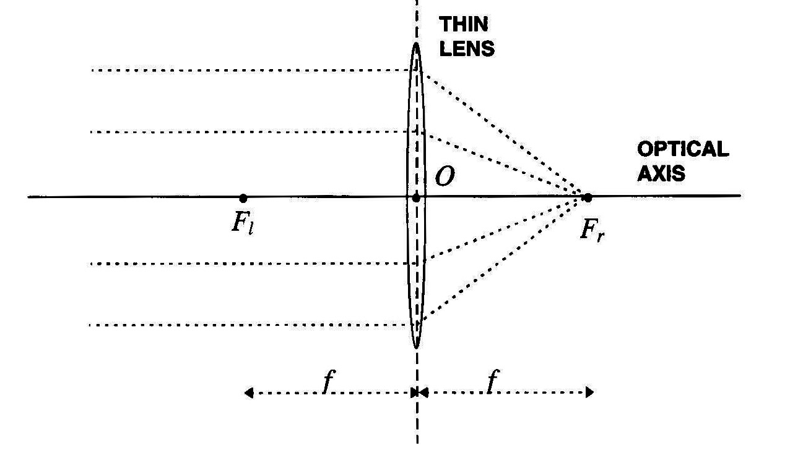
Camera with Lens - Thin Lens Model
Basic properties
Any ray entering the lens parallel to the axis on one side goes through the focus on the other side.
Any ray entering the lens from the focus on one side emerges parallel to the axis on the other side.

Slide 10
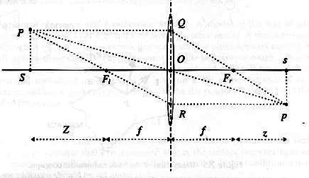
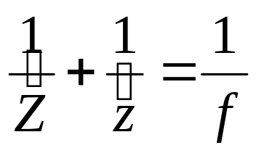
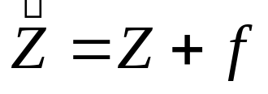
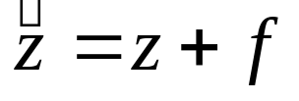
Fundamental Equation of Thin Lenses
Similar triangles: PSFl~ORFl and QOFr~spFr
|PS| = |QO| and |sp| = |OR|

Slide 11
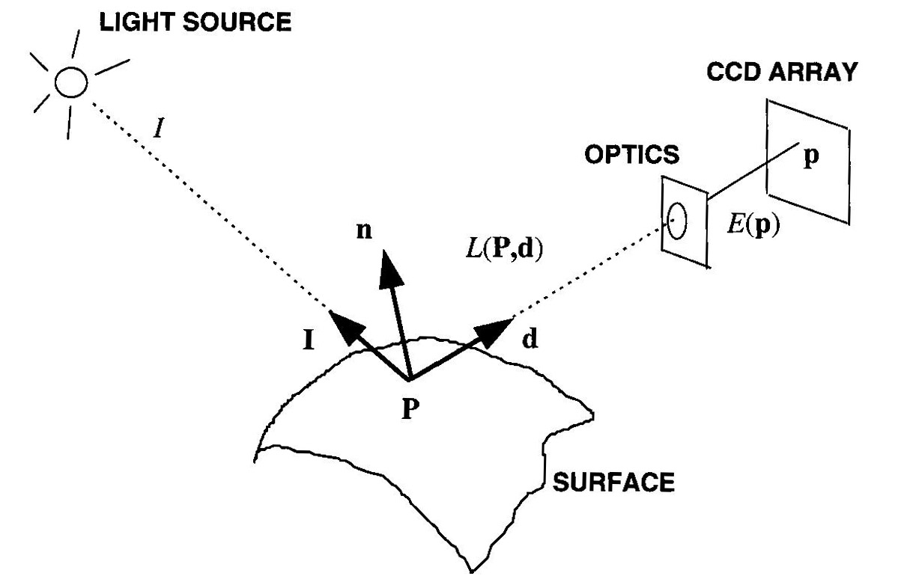
Basic radiometry
Image Irradiance: the power of light, per unit area and at each point p of the image plane.
Scene Radiance: the power of the light, per unit area, ideally emitted by each point p of a surface in 3-D space in a given direction.

Slide 12
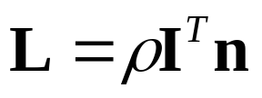
Surface Reflectance and Lambertian
is called surface
albedo.
Lambertian model: each surface point appears equally bright
from all viewing directions.

Slide 13
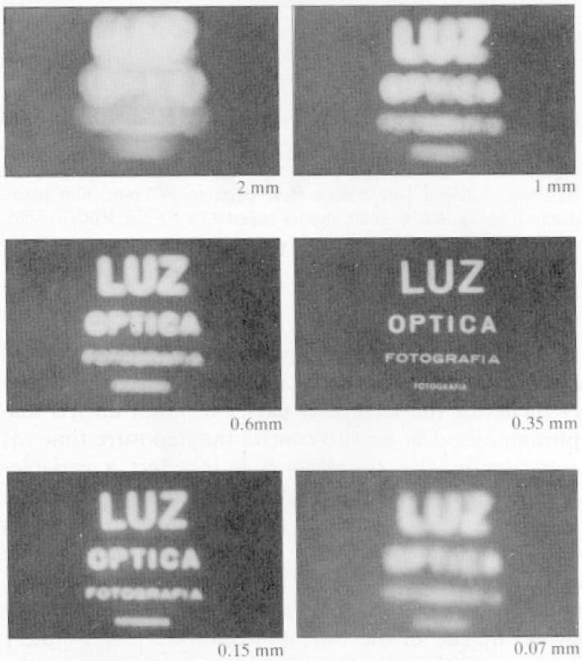
Why Lenses?
Pinhole too big - many directions are averaged, blurring the image
Pinhole too small - diffraction effects blur the image
Generally, pinhole cameras are dark, because a very small set of rays from a particular point hits the screen.

Slide 14
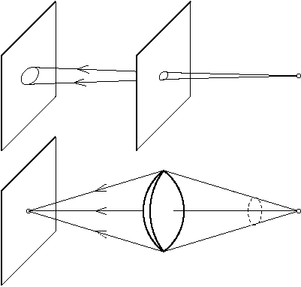
Why Lenses?
Gather more light from each scene point

Slide 15
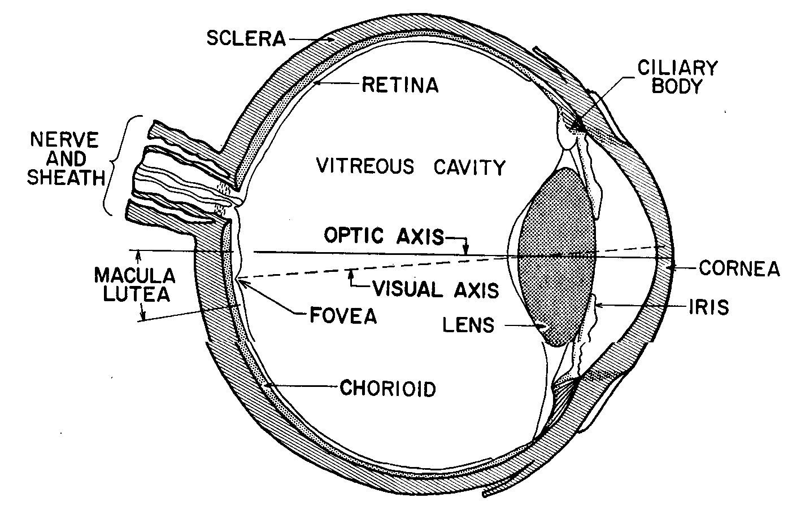
Human Eye

Slide 16
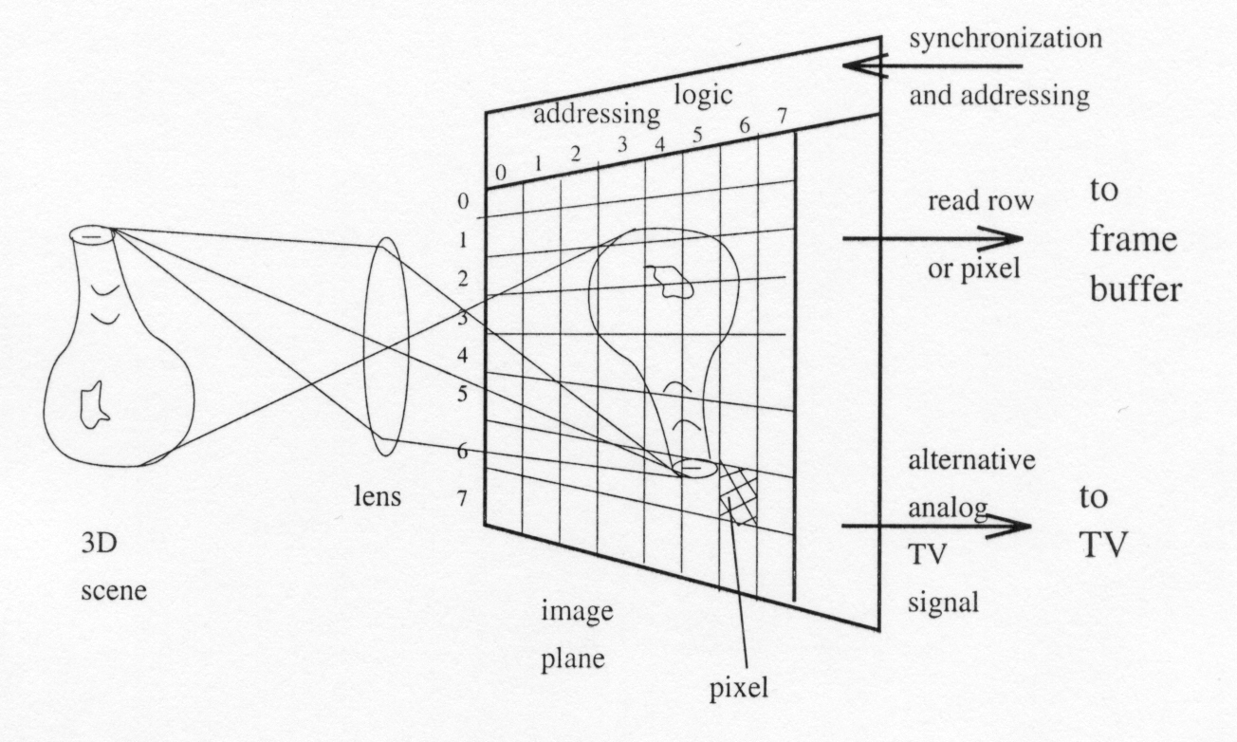
CCD (Charge-Coupled Device) Cameras
Small solid state cells convert light energy into electrical charge
The image plane acts as a digital memory that can be read row by row by a computer

Slide 17
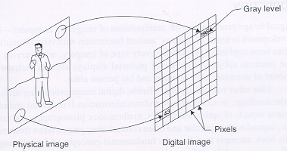
Image Digitization
Sampling – measuring the value of an image at a finite number of points.
Quantization – representing the measured value at the sampled point, by an integer.
Pixel – picture element, in the range [0,255]

Slide 18


Grayscale Image
10
5
9
100
A digital image is represented by an integer array E of m-by-n.
E(i,j), a pixel, is an integer in the range [0, 255].

Slide 19
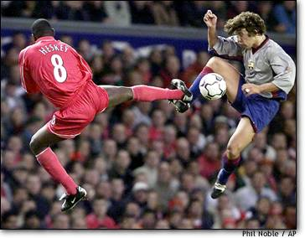
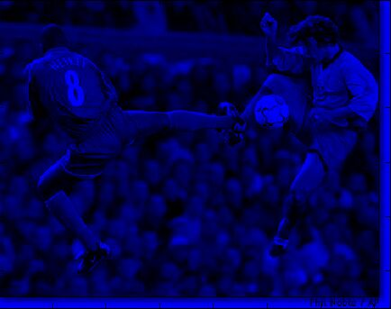
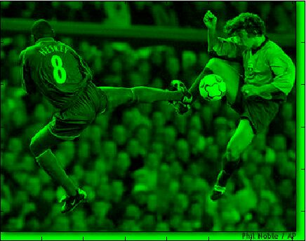
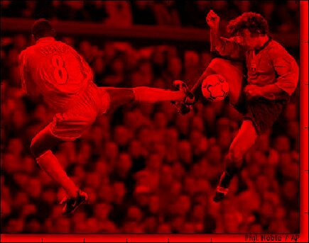
Color Image
B
G
R

Slide 20
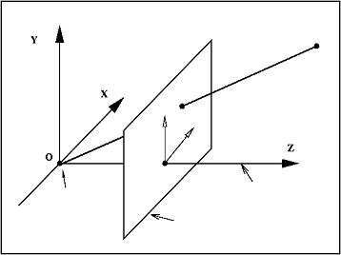
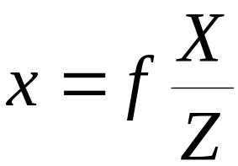
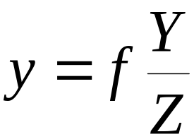
Geometric Model of Camera
Perspective projection
P
P(X,Y,Z)
p(x,y)
p
y
x
principal
point
principal
axis
optical
center
image
plane

